Slide 1
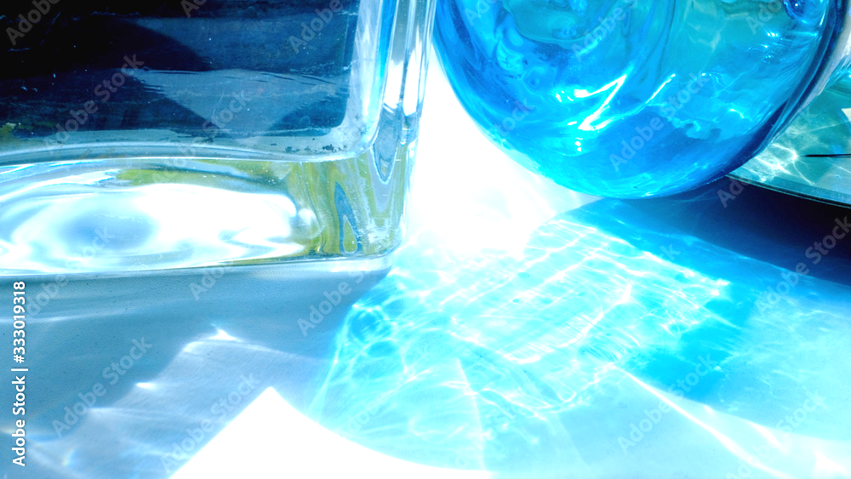
Glass materials
PRODUCTION AND APPLICATIONS
CL-304
Rohit chalak ronit malvi sabir singh​
210107073 210107074 210107075​

Slide 2
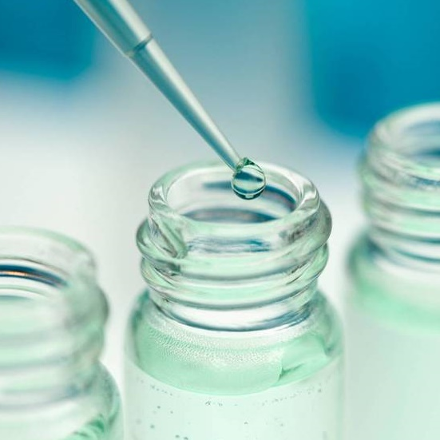
GLASS
Glass is a hard brittle transparent or translucent non-crystalline solid, consisting of metal silicates or similar compounds.
Glass has three important properties that have made it indispensable as a building material in modern civilization: its hardness, its transparency, and its chemical resistance.
SCIENTIFIC DEFINITION:
Glass my be defined: physically as a rigid, undercooled liquid having no definite melting point and a sufficiently high viscosity (greater than 10¹³ poises) to prevent crystallization; chemically as the union of the nonvolatile inorganic oxides resulting from the decomposition and fusing of the alkali and alkaline earth compounds, sand, and other glass constituents.

Slide 3
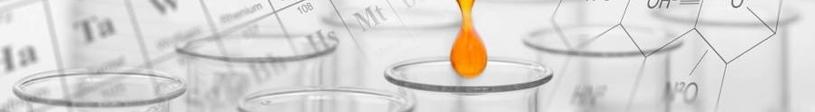
Timeline
A legend says Phoenician merchants accidentally made glass while cooking.
Venice dominated glass production during medieval times.
The American glass industry started in the 17th century but remained stagnant for a long time.
Today, the glass industry is a modern field that uses science for production, quality control, and development.
6,000-5,000 BC
290 AD
12th century
1688
Late 19th century
Window glass
Hand-blown window-glass cylinder is invented
Plate glass is first made in France
Lubbers invents a mechanical adaptation for window-glass production
Egyptians make glass jewelry

Slide 4
Chemical composition of typical glasses

Slide 5

Commercial glass
Lime, silica, and soda still form over 90 per :cent of all the glass of the world, just as they did 2,000 years ago.
Regular glass is made by melting sand (silicon dioxide) and soda ash (sodium carbonate). This type of glass dissolves in water and is commonly used as a glue (water glass) in cardboard boxes, fireproofing, and egg preservation. Stronger versions are used in detergents and soaps.
Lead glass is special because it bends light more than regular glass (high refraction) and separates different colors of light well (high dispersion). This makes it good for lenses and prisms. It's also used in light bulbs and electronics because it doesn't conduct electricity.
Vitreous silica is a special type of glass made almost entirely from silica. It's different from regular glass because:It can withstand very high temperatures without melting or breaking easily. It allows light, especially ultraviolet light, to pass through very well.
This makes it useful for things like high-temperature crucibles, lenses for telescopes, and windows in spacecraft.

Slide 6
Commercial glass
Lime, silica, and soda still form over 90 per :cent of all the glass of the world, just as they did 2,000 years ago.
Borosilicate glass is a special type of glass with around 10-13% boron oxide added. This makes it:
More resistant to sudden temperature changes (shockproof).
Less likely to react with chemicals
A good insulator for electricity
This has led to its use in many everyday items like cookware, lab equipment, and even electrical components.
Lime glass is the most common type of glass, used in windows, bottles, dishes, and more. It's made from a specific mix of silicon dioxide (sand), calcium oxide (lime), and sodium oxide (soda ash). This mix makes the glass affordable, easy to work with, and melts at a good temperature.

Slide 7
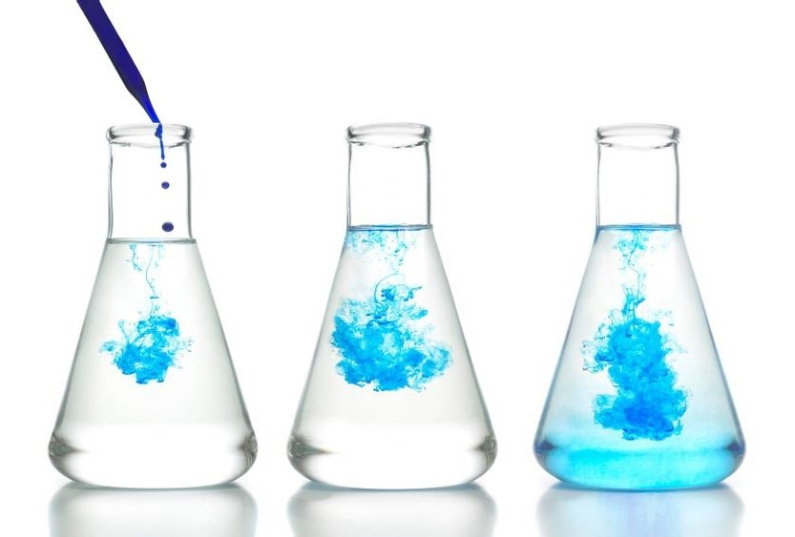
Raw Materials
Glass Sand (pure quartz)
Soda , Na₂O
Feldspars , R₂0.Al₂0₃.6SiO₂
Borax , Na₂B₄O₇. 10H₂O
Salt Cake , impure Na₂SO₄
Cullet / waste glass

Slide 8
Chemical reactions
Na₂CO₃ + a.Si0₂ → Na₂0.aSi0₂ + CO₂
CaC0₃ + b.Si0₂ → CaO.bSi0₂ + CO₂
Na₂SO₄ + c.Si0₂ + C → Na₂0.cSi0₂ + S0₂ + CO
(Silica) (sodium silicate)
(Silica) (calcium silicate)
(Silica) (sodium silicate)

Slide 9
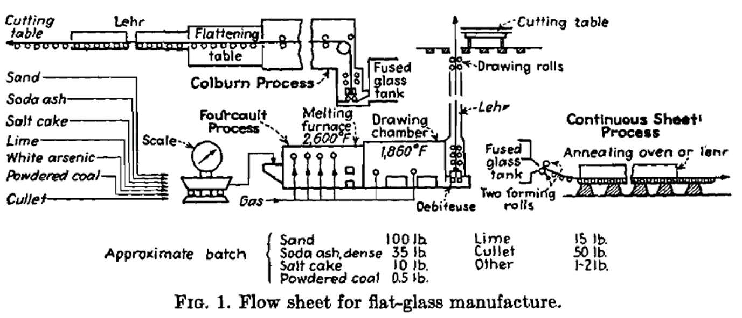
Flat –Glass Manufacture

Slide 10
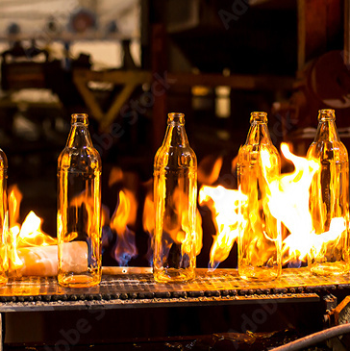
Unit process and operations
Transportation of raw materials to plant (Op.)
Sizing of some raw materials (Op.)
Storage of raw materials (Op.)
Conveying to, weighing and feeding raw materials into glass furnace (Op.)
Reacting in furnace to form the glass (Pr.)
Burning of fuel to secure temperature needed for glass formation (Pr.)
Heat saving by regeneration or recuperation (Op.)
Shaping of glass products (Op.)
Annealing of glass products (Op.)
Finishing of glass products (Op.)
Manufacturing Process
Pr. → Process
Op. → Operation

Slide 11
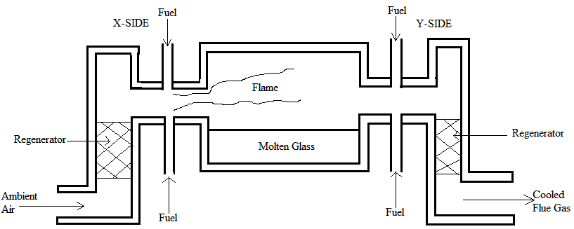
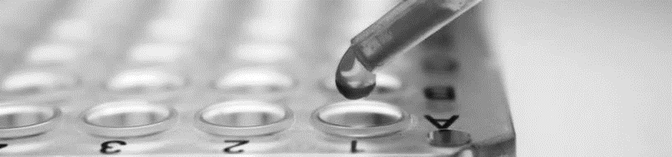
melting
Glass furnaces are classified as pot or tank, with subclasses of regenerative or recuperative.
Pot furnaces, with capacities up to 2 tons, are used for specialty glasses, protected by clay or platinum crucibles.
Tank furnaces, holding up to 1,400 tons, operate continuously, with glass forming a pool in a refractory hearth.
Regenerative furnaces use cycles to preheat air and fuel, while recuperative furnaces preheat air continuously.
Regenerative furnaces save heat efficiently, maintaining temperatures over 2200°F.
Melting costs around $2 per ton, with most heat lost through radiation.
Water cooling pipes in furnace walls reduce glass-furnace interaction.

Slide 12
shaping
Glass may be shaped by either machine or hand molding. The outstanding factor to be considered in machine molding is that the design of the glass machine should be such that the article is completed in a very few seconds.
Before World War 1, plate glass was made by pouring molten glass onto a giant cast iron table and rolling it flat with a water-cooled roller. This required a lot of skill to get the right thickness and avoid imperfections. Today, this method has been completely replaced by more advanced processes.
Flat window glass used to be made by blowing and flattening. Today, it's continuously produced in sheets by either drawing molten glass down (Fourcault) or drawing and shaping it over a roller (Colburn).
Modern light bulb factories use machines with air pressure. Melted glass forms a ribbon, air shapes it into blobs, and spinning molds turn them into bulbs. These machines can make hundreds of bulbs per minute.

Slide 13
annealing
Annealing glass involves:
(1) holding a mass of glass above a certain critical temperature long enough to reduce internal strain by plastic flow to less than a predetermined maximum
(2) cooling the mass to room temperature slowly enough to hold the strains below this same maximum.
This process occurs in a lehr, a heated chamber with controlled cooling rates. Quantifying stress and birefringence aids in designing glass for specific mechanical and thermal conditions.
Engineers have developed continuous annealing equipment with automatic temperature regulation and circulation control, improving annealing efficiency, reducing fuel costs, and minimizing product loss.

Slide 14
FINISHING
All types of annealed glass must undergo certain finishing operations, which, though relatively simple, are very important. These include cleaning, grinding, polishing, cutting, sandblasting, enameling, grading, and gaging. Although all of these are not required for every glass object, one or more is almost always necessary.

Slide 15
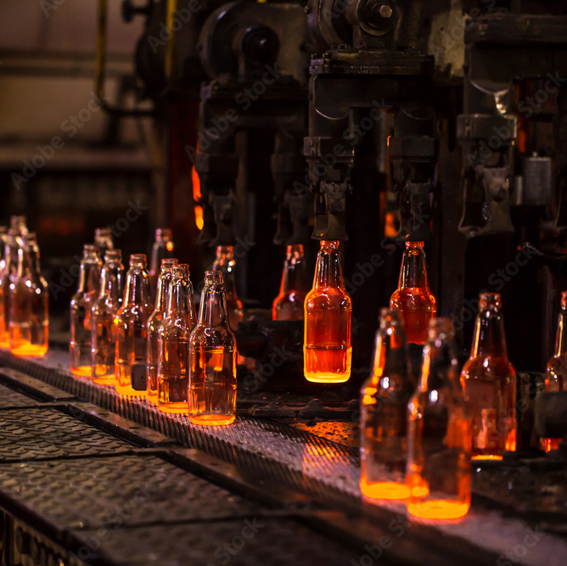
Application of glass materials
Glass is valuable in chemical engineering because it's affordable, hard, smooth, doesn't expand much with heat, and resists chemicals.
It's used in 3 main ways: 1) Large equipment like pipes and towers, 2) As a protective coating on metal tanks and reactors, and 3) As fibers for insulation and other applications.
But for chemical plants, only special glass like borosilicate glass or pure fused silica are typically used due to their superior properties.

Slide 16

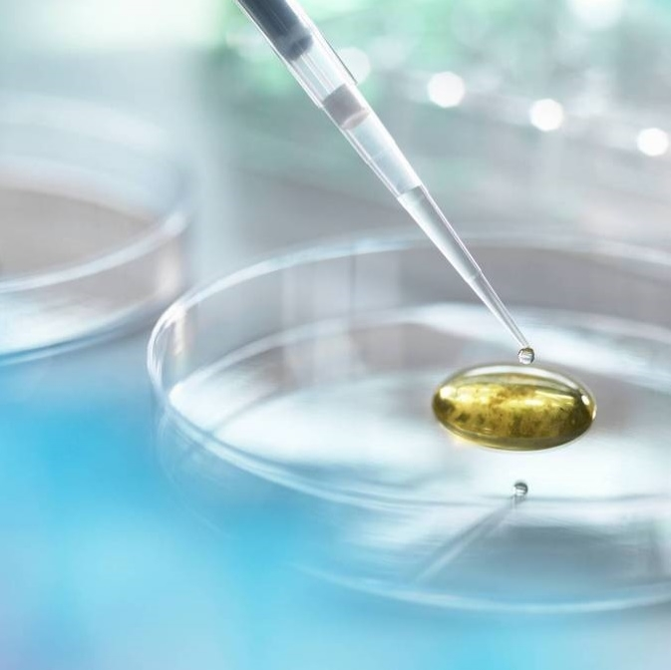
Thank you

